Slide 1
Herzlich Willkommen
6. Juni 2024
A07591000
Bosch Rodez
Assembly Solenoid Armature

Slide 2
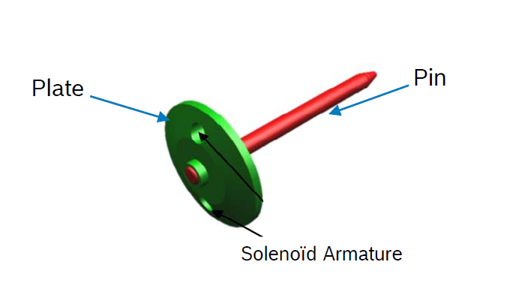
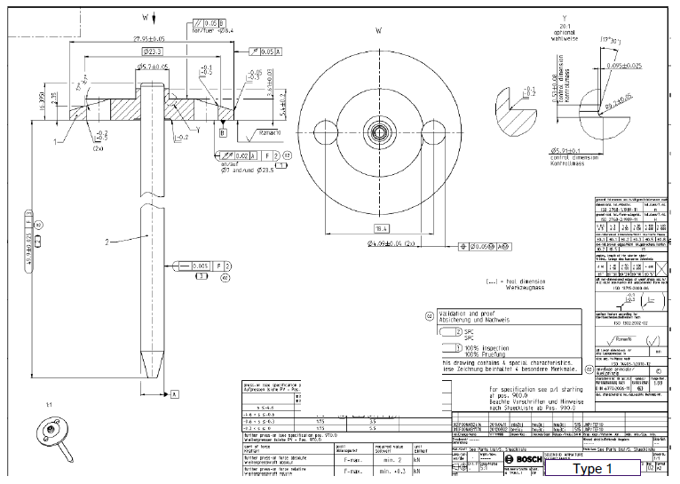
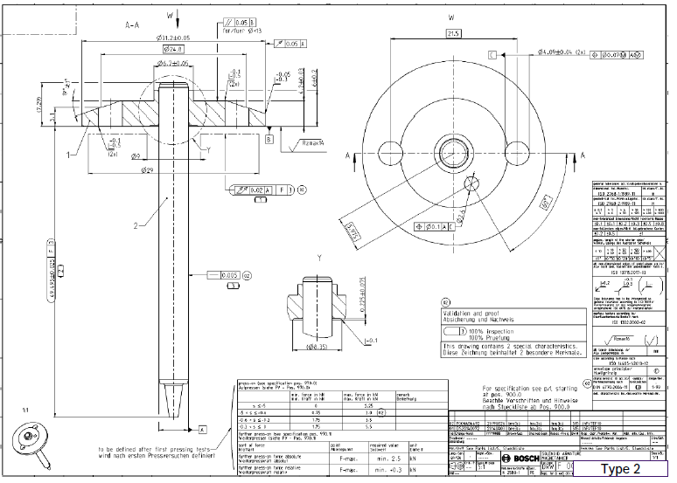
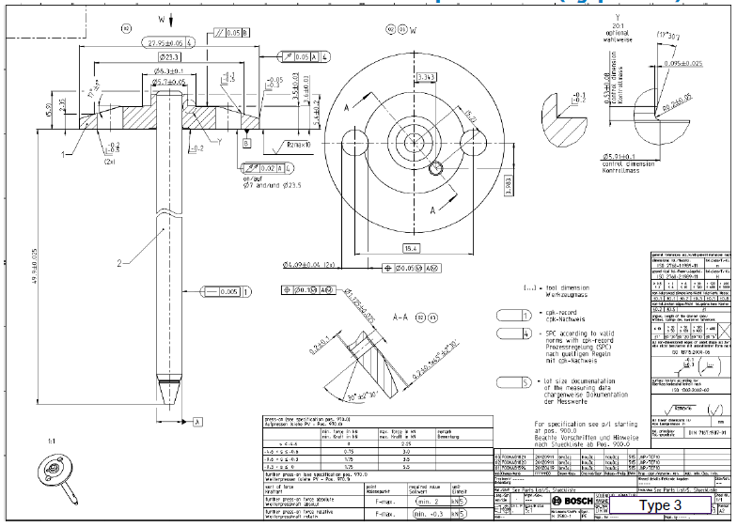
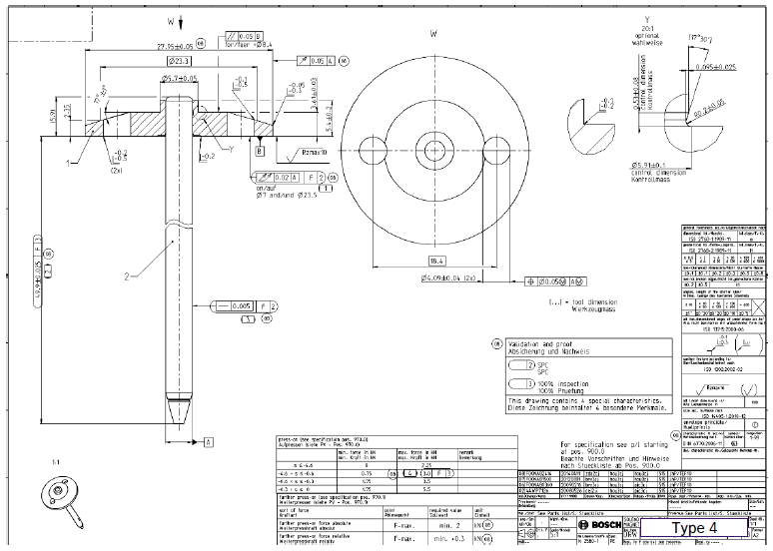
Cycle time: 8,2 sec.
Type 1
Type 2
Type 3
Type 4
5 kN
±0,025
1
Feed pin
(tray 300 pcs.
200x400mm)
2
Feed plate
(bulk - bowl feeder
capacity 300 pcs.)
6
Press
(Kistler press)
7
Check
(Heidenhain gauge)

Slide 3
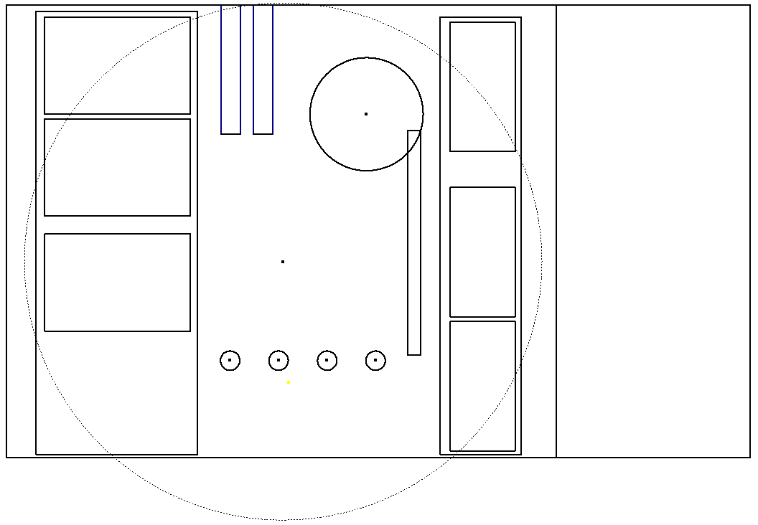
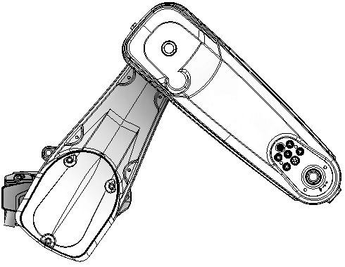


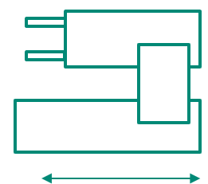
Plate
Bulk - bowl feeder
capacity min. 300 pcs.
Pin
Tray 200x400
capacity 300 pcs.
1
Feeder pin
Tray 200x400
capacity 300 pcs.
Feeder plate
Bulk - bowl feeder
capacity min. 300 pcs.
Handling plate
Plate from vibration rail to press station
DMC-reader
Handling pin / pin with plate
pilgrim step handling
Robot handling pin / pin with plate
Stäubli robot with gripper
Press station
Kistler NC joining module (Type: 2153A0102003HG)
Check station
Check the lenght of assembled parts wirth Heidenhain gauge
Paletizer for assembled parts
Tray 300x450; capacity 50 pcs.
Palletizer with 2x6 trays
6x full / 6x empty
NIO drawer
Drawer for 10 parts
SPC drawer
Drawer for 10 parts
2
2
1
9
10
3
8
Solenoid Armature
Tray 300x450
capacity 50 pcs.
Palletizer with 2x6 trays
6x full / 6x empty
6x empty tray
4
5
6x full tray
6
5
1400
7
4
8
7
6
3
9
Check
Press
10
2400
Cycle time: 8,2 sec.

Slide 4
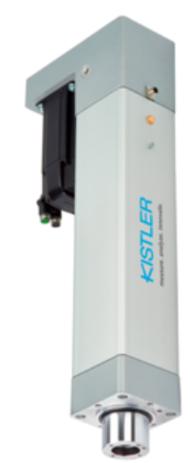
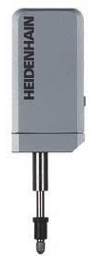
F = max. 5,5kN
v = 100 ±50 mm/min
Pressing time max. 4 sec.
from bowl feeder (handling)
bowl feeder capacity min. 300 pcs.
into tray (robot)
tray 50 pcs. 300x450mm
from tray (robot)
tray 300 pcs. 200x400mm
±0,025
±0,025
7
Check
(Heidenhain gauge)
6
Press
(Kistler press)
Cycle time: 8,2 sec.

Slide 5
Danke
für die Aufmerksamkeit

Slide 6
Typerkennung vor Montage - Kamera?
DMC auf Teile?
Typ des Trays Geometrie Bauform
DMC auf Tray erkennen?
NIO- Teile?
SPC-Teile?
MES-Teileverfolgung?

Slide 7
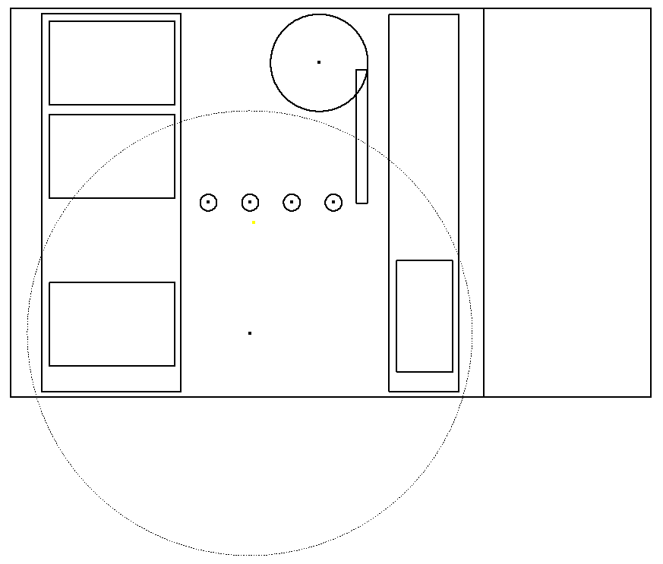
Plate
Bulk - bowl feeder
capacity min. 300 pcs.
Pin
Tray 200x400
capacity 300 pcs.
2
1
8
Solenoid Armature
Tray 300x450
capacity 50 pcs.
Palletizer with 2x6 trays
6x full / 6x empty
7
6
Check
Press
3
1400
4
5
2400
Cycle time: 8,2 sec.

